Slide 1
ARIZONA HOUSING FORUM
LIHTC Cost Containment
Presented by

Slide 2
Overview
Company Introduction
Review of Historical Cost Trends
Factors that Impact Project Costs
General
Architect and Engineer Selection
Contractor Selection
Site Selection
Location & In-fill
Building Efficiencies
Green Building
Value Engineering
Forecast of Construction Costs

Slide 3
Company Introduction
T.A. Construction Company, Inc. was formed in 1984
TA Construction & Wallick Companies formed TA-Wallick Construction LLC in 1998
TA and Wallick dissolved their corporation in 2005
In 2005, renamed the company to Tofel Construction

Slide 4
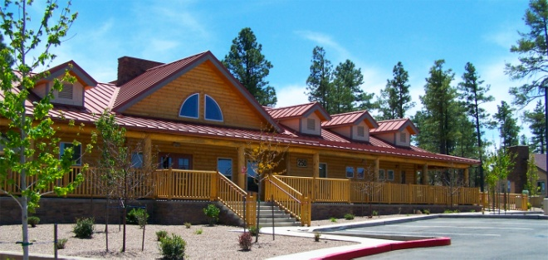
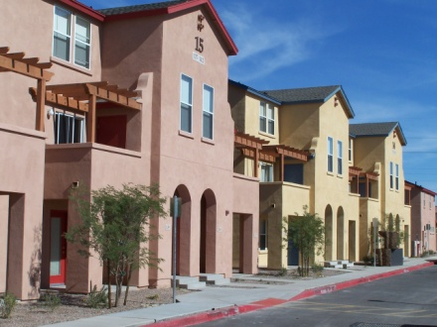
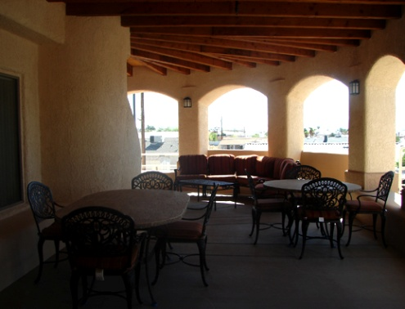
Multifamily Housing Completed by Type
Tax Credit projects – 60
HUD projects – 28
Affordable Housing projects – 78
Luxury Housing projects – 7
Market-rate Housing projects – 29
Rehab projects – 14
Senior living projects - 18

Slide 5
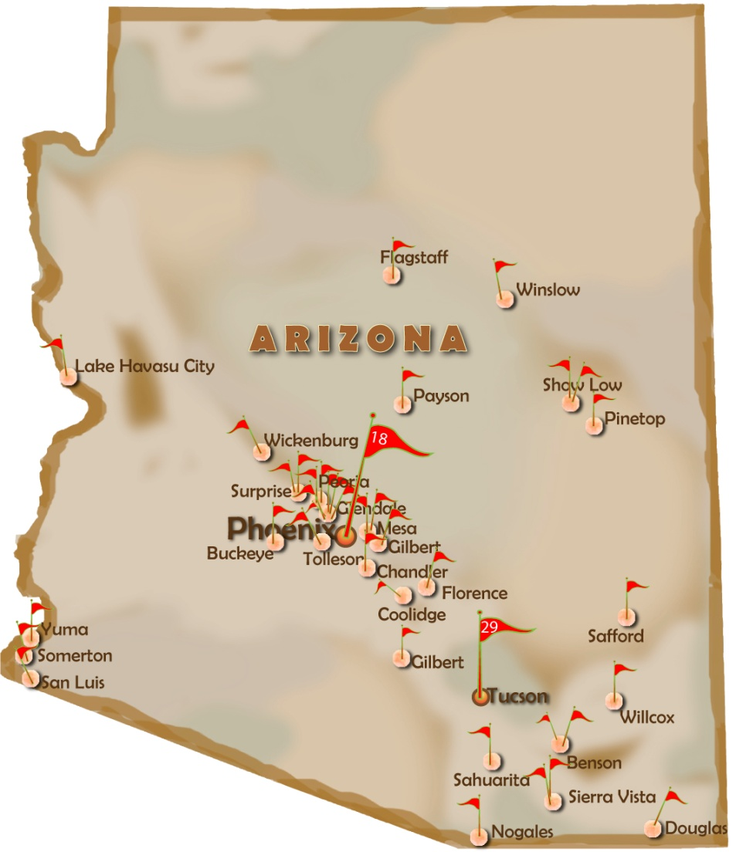
Multifamily Construction Specialists - AZ
Benson (2) both Tax Credit
Buckeye (1) Tax Credit
Chandler (1)
Coolidge (1) Tax Credit
Douglas (1) Tax Credit
Flagstaff (1)
Florence (1) Tax Credit
Gilbert (1)
Glendale (5) 3 were Tax Credit
Lake Havasu City (1) Tax Credit
Mesa (2) 1 was a Tax Credit
Nogales (1) Tax Credit
Peoria (2) 1 was a Tax Credit
Payson (1) Tax Credit
Phoenix (18) 12 were Tax Credit
Pinetop (1) Tax Credit
Safford (1) Tax Credit
Sahuarita (1) Tax Credit
San Luis (1)
Show Low (2) both Tax Credit
Sierra Vista (1)
Somerton (1) Tax Credit
Surprise (2) both Tax Credit
Tolleson (1) Tax Credit
Tucson (29) 10 were Tax Credit
Wickenburg (1) Tax Credit
Willcox (1) Tax Credit
Winslow (1) Tax Credit
Yuma (1) Tax Credit

Slide 6
Multifamily Construction Specialists - NM
Albuquerque (3) all Tax Credit
Bloomfield (1) Tax Credit
Clovis (2) both Tax Credit
Gallup (1) Tax Credit
Rio Rancho (1) Tax Credit
Santa Fe (1)
Taos (1) Tax Credit
Texico (1) Tax Credit

Slide 7
Historical Review of Cost Trends

Slide 8
Cost per SF Analysis

Slide 9
Factors that Impact Project Costs
Financing
Davis-Bacon
Residential (+5%) vs Commercial wage rates (+25%)
Section 3
Generally not a cost impact, just paperwork issue

Slide 10
Architect and Engineer Selection

Slide 11
Architect and Engineer Selection
Key selection criteria
Have engineers work under the architect
Discuss timelines up front and set up regular progress review meetings
Collaboration with Owner and Contractor is critical
Local architects understand local conditions
For LIHTC projects, experience helps
Must have strong multi-family resume
Potential Pitfalls
Architects can impact building costs by as much as 25%
Many civil engineers don’t consider cost containment a key success criteria
Structural engineers who don’t have experience with Post-tension slabs tend to add additional “fudge” factors into their calculations
Mechanical and Electrical Engineers can double the costs of those trades if not designed properly

Slide 12
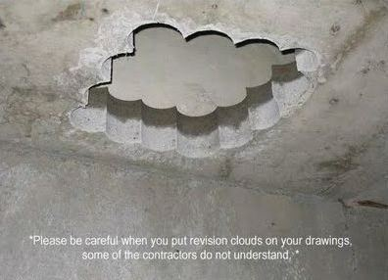
Contractor Selection

Slide 13
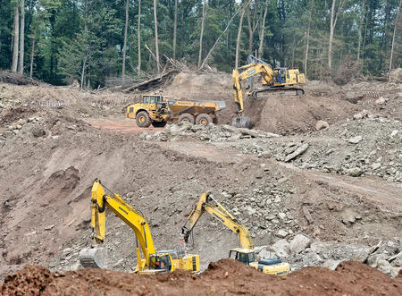
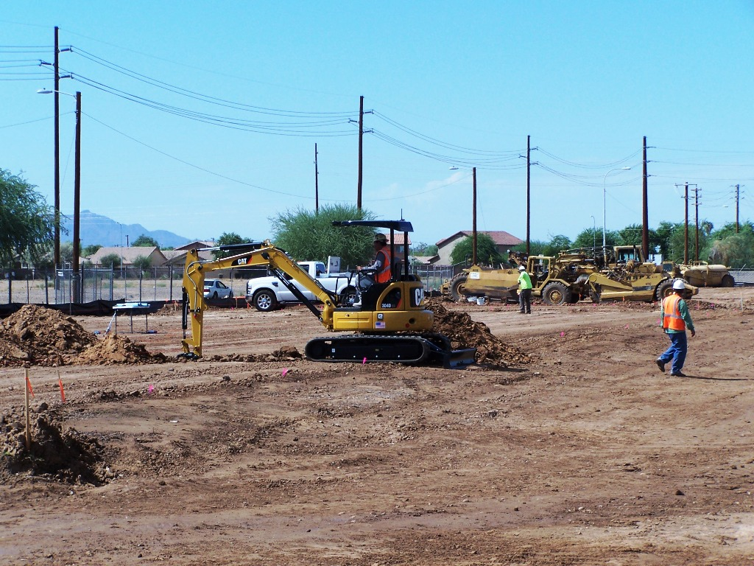
Site Selection
What is the difference in construction costs between these two sites?
Vs.

Slide 14
Site Selection
 | Mountain Area | Desert Area
Units | 60 | 60
Buildings | 12 | 12
Total SF | 52,433 | 45,610
Lot Size | 7.11 Acres | 6.39 Acres
Soil | Very-Expansive Clay | Silty-Sand
Hard Dig | Yes | No
Import | 11,000 CY | Balanced Site
Retaining Walls | 693 LF | 0 LF
Buildable Months/Yr | 10 - 11 | 12
Site Costs | $2,437,000 | $1,520,000
Slab Costs | $647,743 | $528,080
Total Cost / Unit | $139,000 | $112,000

Slide 15
Project Location
What is the cost difference between rural and Tucson / Phoenix based projects?

Slide 16
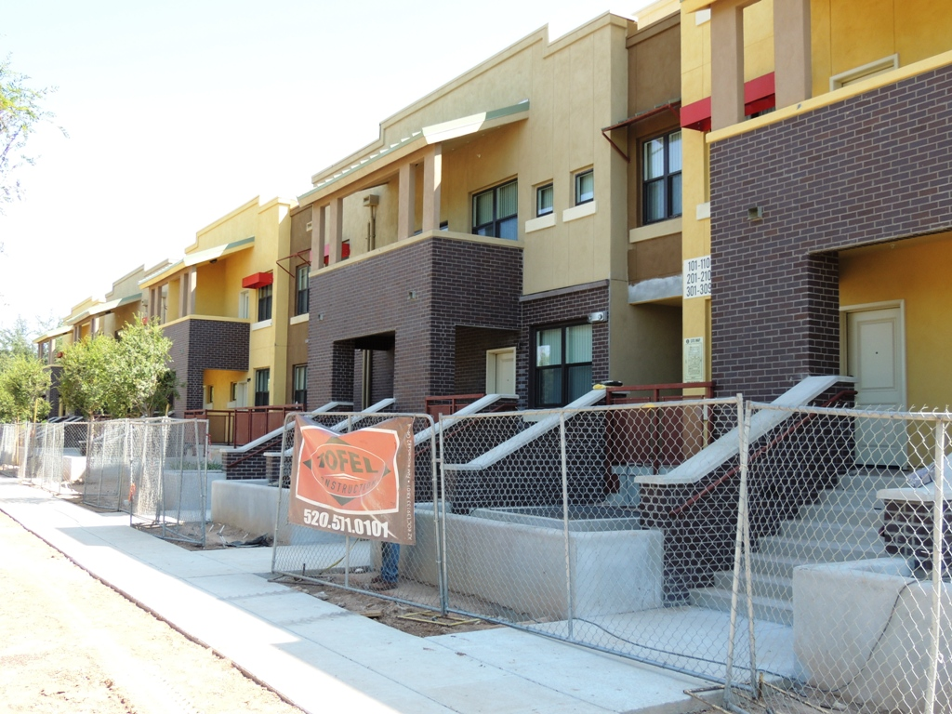
In-fill project considerations
Cost Drivers
Demolition / Abatement
Structured Parking ~ $12k per stall vs. $1k for surface
City’s typically make you upgrade off-site water / sewer lines
Phoenix new downtown development code
Cost / SF increases as a building gets to be over 4 stories
Staging / Shoring / Traffic Control can all add costs

Slide 17
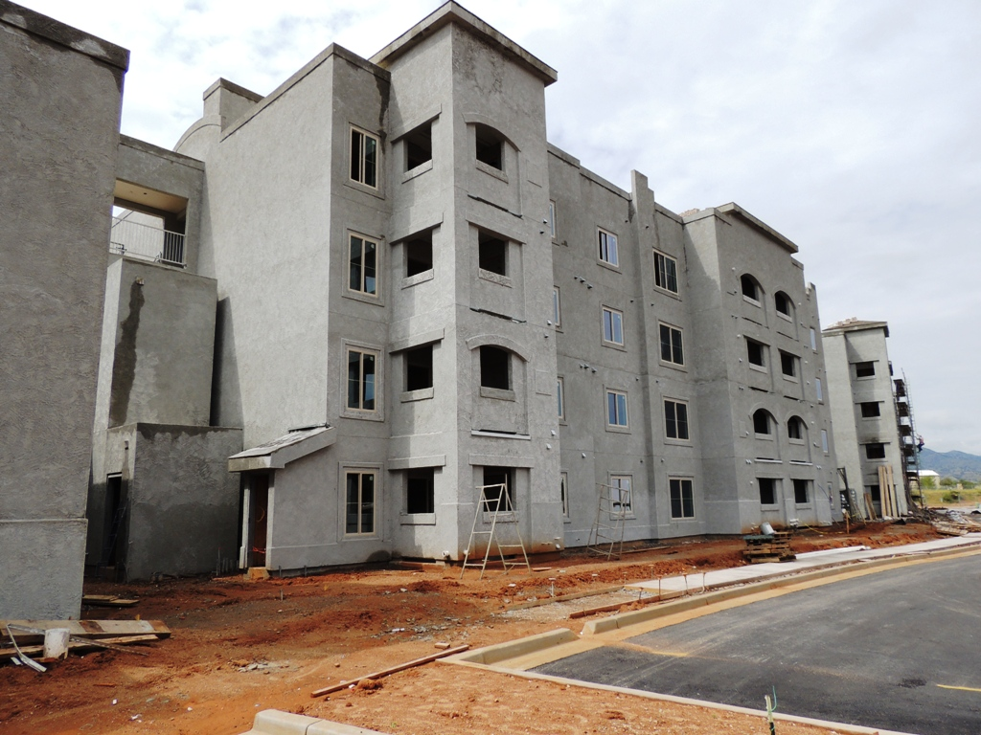
Building Efficiency
How many units?
How many stories?
Interior Corridors vs. exterior catwalks?
Impact of elevators

Slide 18
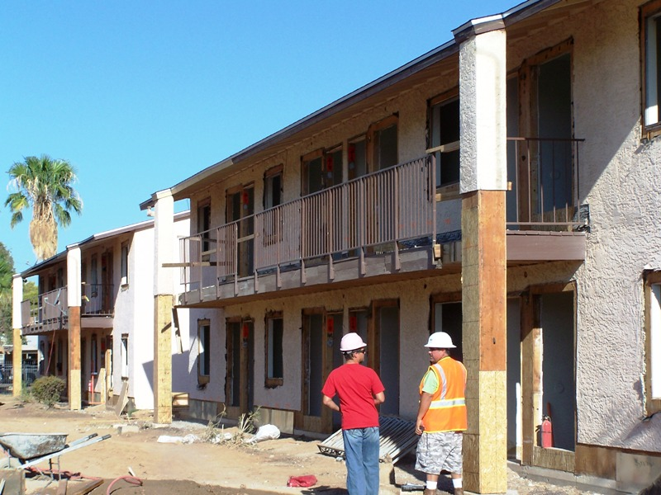
Rehab Cost Drivers
Tenant Relocation
Accurate CNA
Early Contractor & Architect Involvement
Evaluation of Functional Obsolence

Slide 19
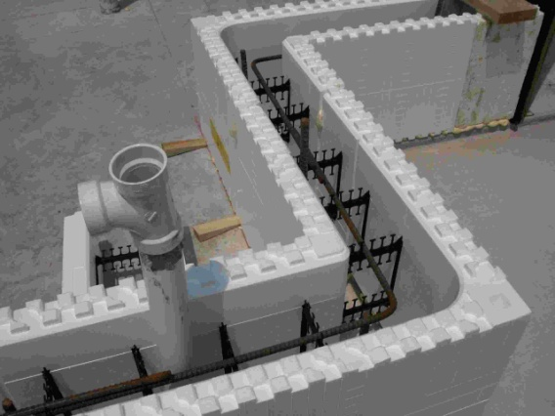
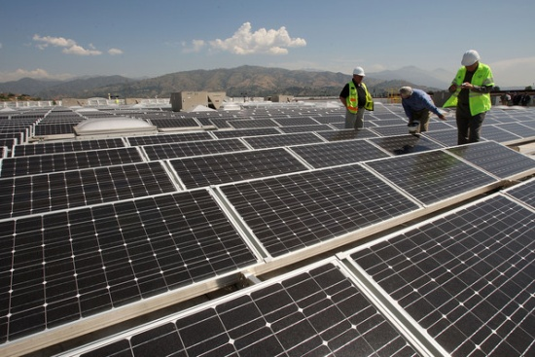
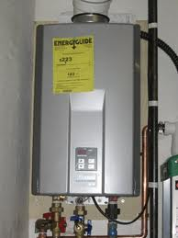
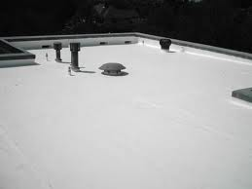
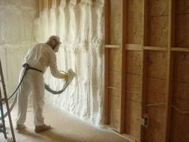
Green and Healthy Construction

Slide 20
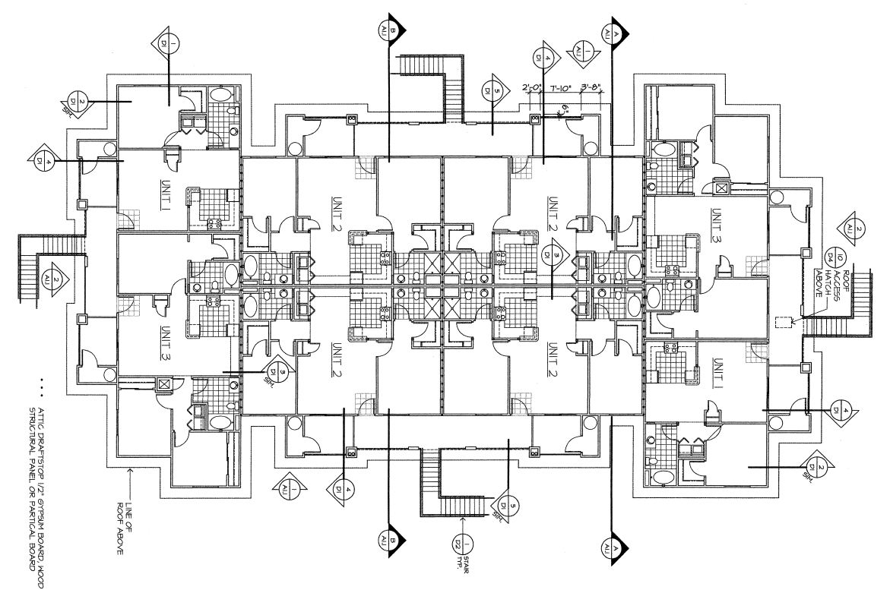
Value Engineering

Slide 21
Forecast of Construction Costs

Slide 22
Closing
Questions?

